Slide 1

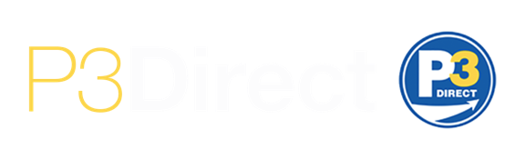

PROJECT DELIVERY BOOTCAMP
The Bond Buyer Infrastructure Conference, September 29, 2025

Slide 2
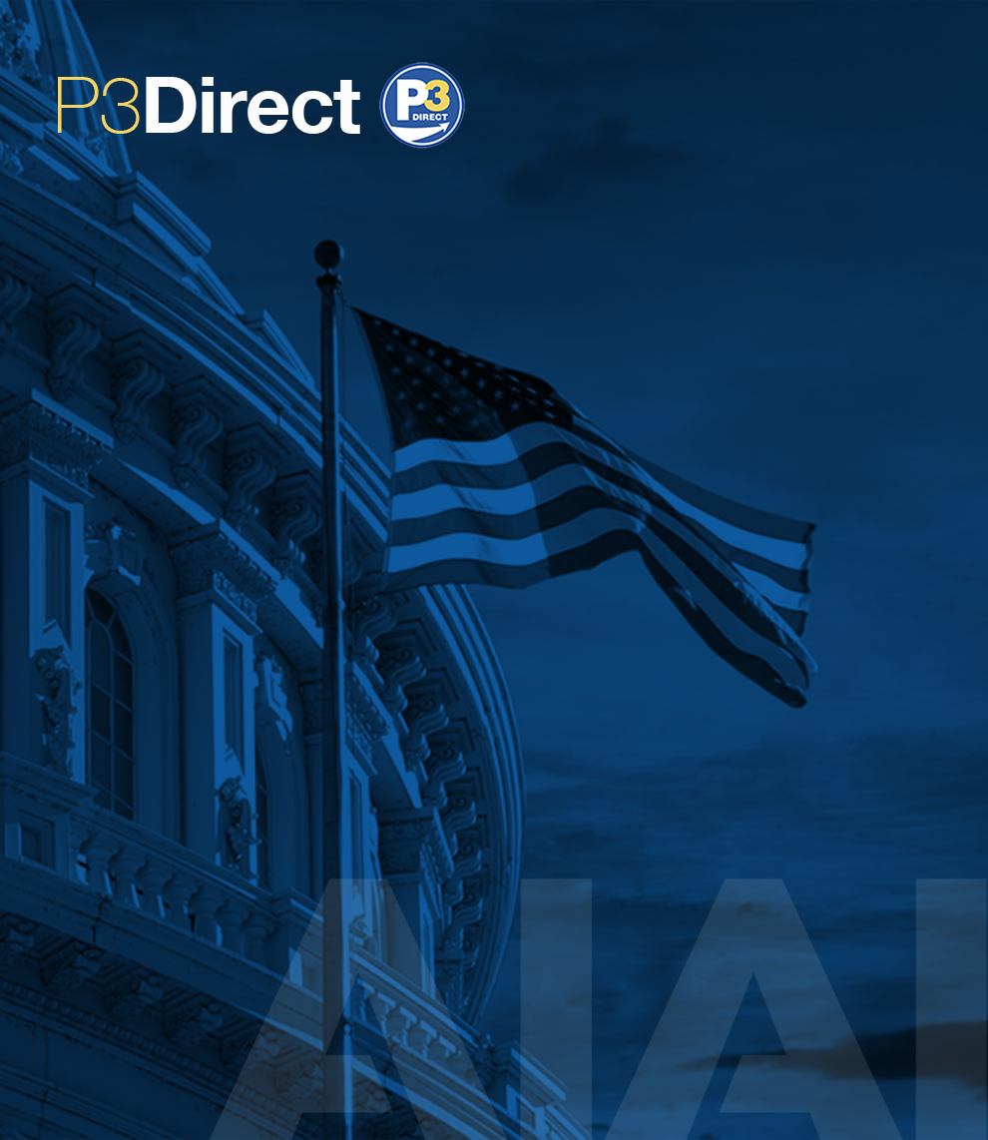
Agenda
Introduction – What is a P3?
Risk Allocation & Value for Money
Break – Lunch
Q&A

Slide 3
What is a P3?
A delivery methodology. Not free money.
A long-term, performance-based contractual agreement between a government agency and a private entity to deliver a publicly-owned asset.
Generally, we consider a P3 to include long-term capital and financing as part of a Design-Build-Finance-Operate-Maintain (DBFOM) contract structure.

Slide 4
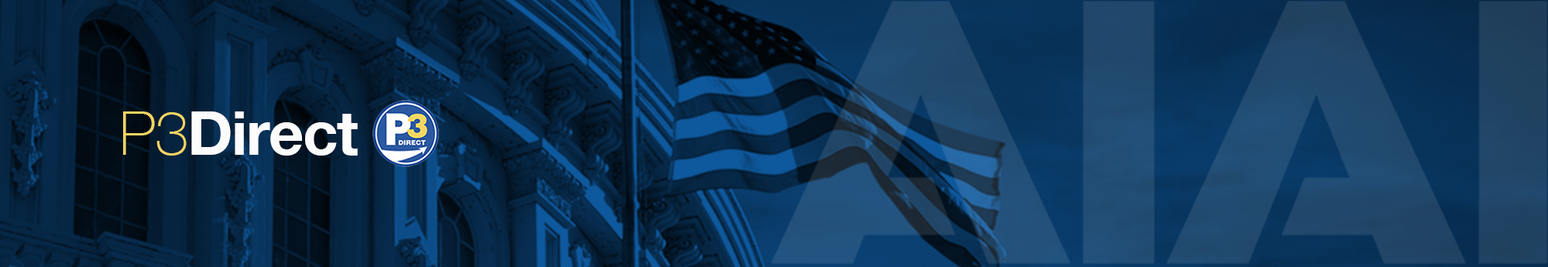
Overview
P3s offer an additional tool in the procurement toolbox to deliver and maintain infrastructure efficiently.
PUBLIC SECTOR PERSPECTIVE
PRIVATE SECTOR PERSPECTIVE
Retain ownership of public asset
Accelerate project delivery
Transfer risks of delivering projects
Long-term life cycle operations & maintenance
Project performance guarantees
Investment opportunity
Fosters innovation
Competitive process and transparency
Notes:
Kyle to speak on Private Sector and moving past the binary past of own or sell
Changing the eco system and giving away value to the private sector

Slide 5
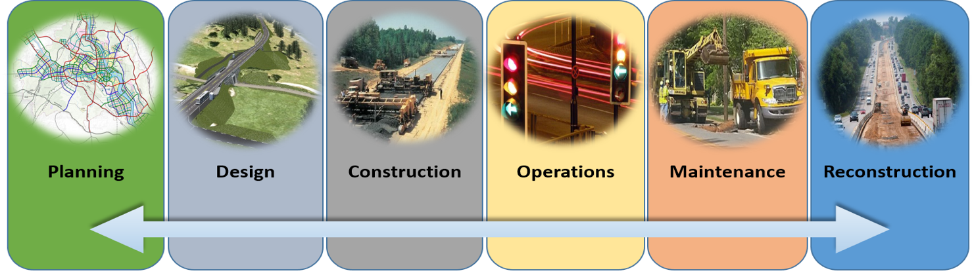
Life Cycle
The whole life of an asset, including planning, design, construction, operations, maintenance, and reconstruction. Life cycle costs include any and all things through the asset life cycle.

Slide 6
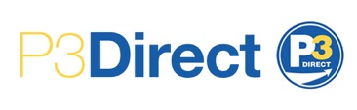












What sectors can P3 be applied to?
The P3 model can be applied to most infrastructure sectors. Infrastructure can be defined as any large capital-intensive asset that provides essential services over a long service lifetime, and in doing so underpins broader economic and community activity. Sectors include transportation, energy, water, and community-based infrastructure.
WATER & SEWAGE TREATMENT PLANTS
MASS TRANSIT
HIGHWAYS
RAIL
AIR &
MARITIME PORTS
EDUCATIONAL FACILITIES
OTHER MUNICIPAL OR COMMUNITY-USE FACILITIES
RENEWABLE ENERGY
HOSPITALS
COURTHOUSES
& JUSTICE
CENTERS

Slide 7










Benefits of a P3
SCHEDULE DISCIPLINE
ACCELERATED DELIVERY
BUDGET CERTAINTY
PUBLIC OWNERSHIP & CONTROL
COST SAVINGS
EFFECTIVE RISK TRANSFER
GREATER INNOVATION
JOB CREATION
LIFE-CYCLE MAINTENANCE
PAYMENT FOR PERFORMANCE/ACCOUNTABILITY

Slide 8
Value for Money
Value for Money Example
Value for Money (VfM) analysis is a process that can be used to compare the financial impacts for the public sector of a P3 project, compared against traditional public delivery alternatives.
The process to establish VfM includes:
Creating a Public Sector Comparator (PSC), which estimates the whole-life cost to the public sector of the project through a traditional procurement approach including development and finance, operations and maintenance, and lifecycle management;
Estimating the whole-life cost of the P3 alternative (either as proposed by a private bidder or a hypothetical “shadow bid” at the pre-procurement stage); and
Comparing results.
Value for Money is an industry-accepted decision driver.
Ancillary Cost
Value for Money
Retained Risk*
Financing Cost
Base Cost
* During construction and throughout lifecycle

Slide 9
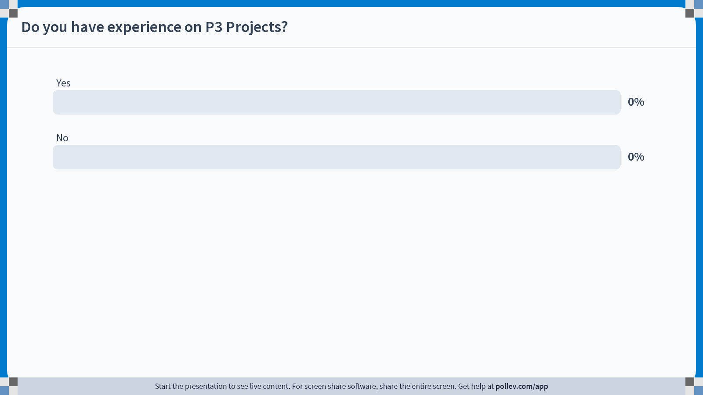
Notes:
Poll Title: Do not modify the notes in this section to avoid tampering with the Poll Everywhere activity.
More info at polleverywhere.com/support
Do you have experience on P3 Projects?
https://www.polleverywhere.com/multiple_choice_polls/vFtdh0CMGB2EmyMqtG30T

Slide 10
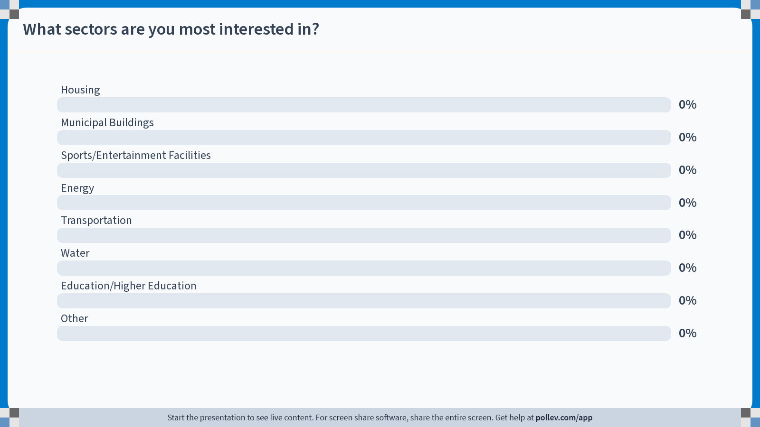
Notes:
Poll Title: Do not modify the notes in this section to avoid tampering with the Poll Everywhere activity.
More info at polleverywhere.com/support
What sectors are you most interested in?
https://www.polleverywhere.com/multiple_choice_polls/r9K8bYDeNL9yBAbqPPYZ0

Slide 11
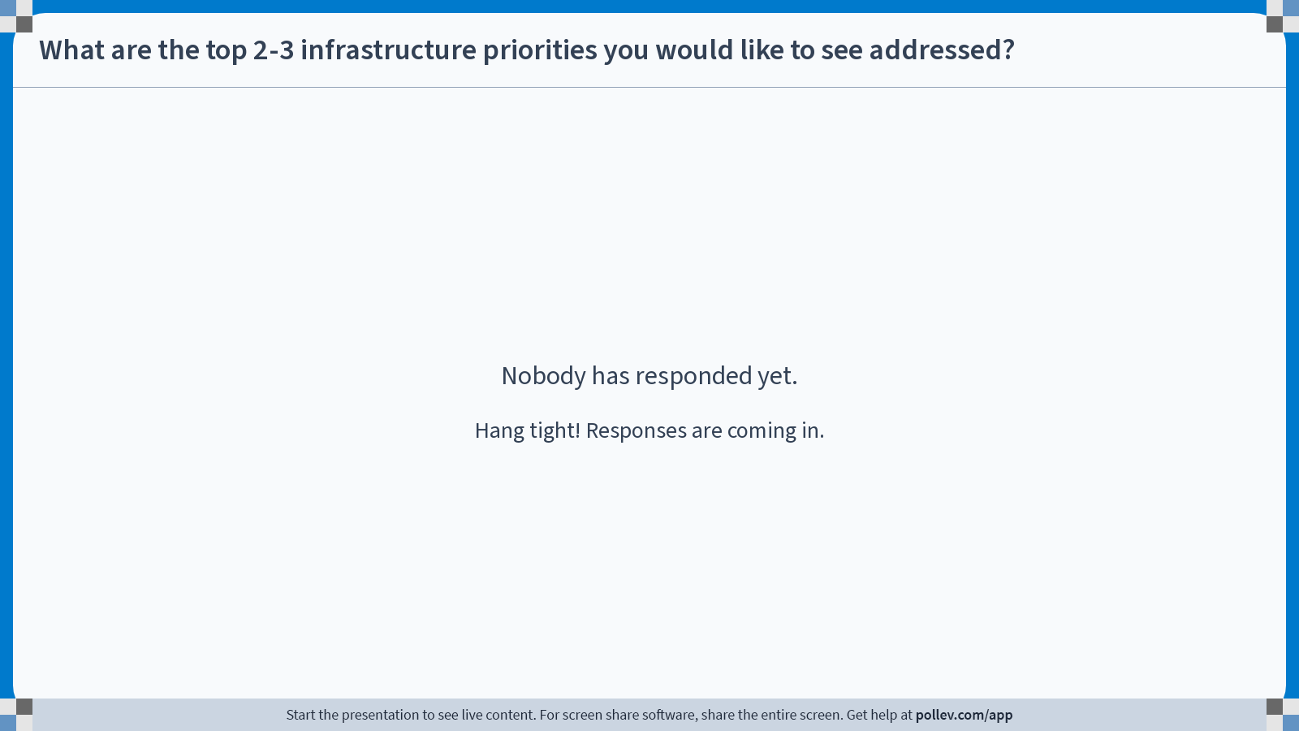
Notes:
Poll Title: Do not modify the notes in this section to avoid tampering with the Poll Everywhere activity.
More info at polleverywhere.com/support
What are the top 2-3 infrastructure priorities you would like to see addressed?
https://www.polleverywhere.com/free_text_polls/y4OZDsMFH1plhI6UAUXVW

Slide 12
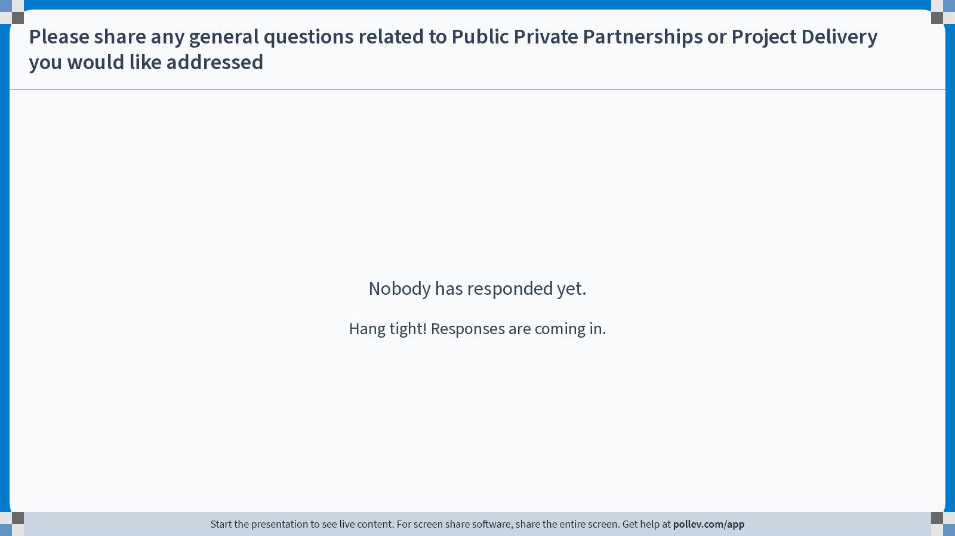
Notes:
Poll Title: Do not modify the notes in this section to avoid tampering with the Poll Everywhere activity.
More info at polleverywhere.com/support
Please share any general questions related to Public Private Partnerships or Project Delivery you would like addressed
https://www.polleverywhere.com/free_text_polls/voW2TweLUgYoIzowvM60e

Slide 13
Delivery methods
Private Finance
DBFOM
DBFOM AP
Private
Sector
DBFM
DBF
Increasing Risk Transfer
Segmented Procurement Packages
Integrated Procurement Package
Outsourcing
DBOM
DB
D = Design,
B = Build,
F = Finance,
O = Operate,
M = Maintain
AP = Availability Payment
DBB = Design, Bid, Build
Public
Sector
DBB
Public Finance
Notes:
Kyle speaking about governments thinking about resetting assets (DC Street lights) and fixing costs (know what x will cost for y # of years)
What is in house and what is externally managed (split shifts at airports, emergency services for buildings, warrenty period and fighting on close out and early life issues)

Slide 14


Fixed Price v Progressive - What’s the difference?
  FIXED PRICE P3 PROCUREMENT (PRICE-BASED)
P3 Screening Business Case
Advisors
Funding
2-Step Procurement Shortlisting
Technical Proposal (30-50% design)
Price Proposal
Feasibility Study
Environmental and Geotechnical Process *
Winner Announced
Commercial Close
Financial Close
Permitting &
Construction
Operations & Maintenance
  PROGRESSIVE P3 PROCUREMENT (QUALIFICATIONS-BASED)
Feasibility Study
Environmental and Geotechnical Process *
Business Case confirmed with Value for Money Determination
Negotiation of final P3 agreement terms, final pricing open book and sub scopes competed
P3 Screening Business Case
Advisors
Funding
Joint project development: financial feasibility, design development, commercial terms, interaction with environmental and geotechnical
Financial
Close
Permitting & Construction
1 or 2-Step Team Selection
* Environmental and Geotechnical process is movable in the timeline depending on the risk transfer desired

Slide 15
Value for Money v Risk Transfer
Optimum VfM
Risk transfer is akin to buying insurance and has a cost
Undertransfer destroys value and overtransfer destroys value
Value for Money
Risk

Slide 16
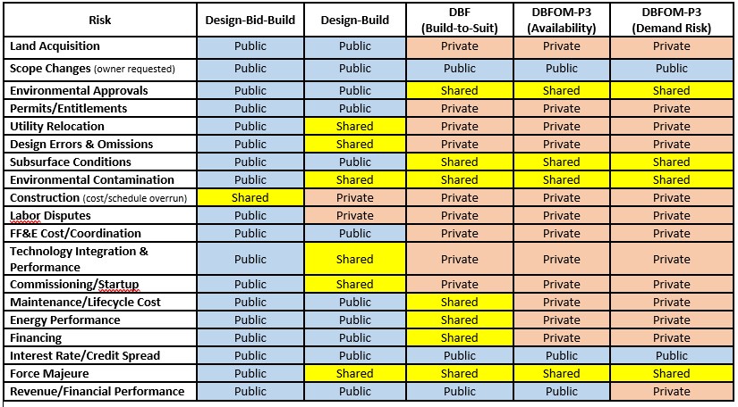
Risk Transfer by Project Delivery
16

Slide 17
Traditional Delivery:
Design-Bid-Build
Design & Construction: Separate contracts.
Design Phase: Separate contract for design services.
Bid Phase: Competitive bidding for construction.
Build Phase: Construction contract awarded.
Funding Sources: Municipal bonds or other forms of government-issued debt are commonly used to raise funds for large infrastructure projects. Some projects may receive grants from federal or state agencies to support specific initiatives.
Operation and Maintenance: Typically falls to the project owner, which is often a government agency or public entity. The costs for operating and maintaining the facility are included in the agency’s annual operating budget. This budget is typically funded through taxes, fees, or other government revenue sources.

Slide 18
P3 Delivery:
Design-Build-Finance-Operate-Maintain
Design & Construction: Single contract
Finance: Project financing typically funded and financed through a combination of private and public sources.
Equity Investment: Private investors, such as construction companies, infrastructure funds, or other private entities, provide equity capital to finance the project.
Debt: A significant portion of the project cost is often financed through debt, which can include loans from banks or bonds issued in capital markets.
Public: The public sector may contribute to the project through direct funding, grants, or subsidies.
Operations & Maintenance: Performance based contracts with long-term, guaranteed funding. Multi-decade agreements for operation and maintenance by the contractor.

Slide 19
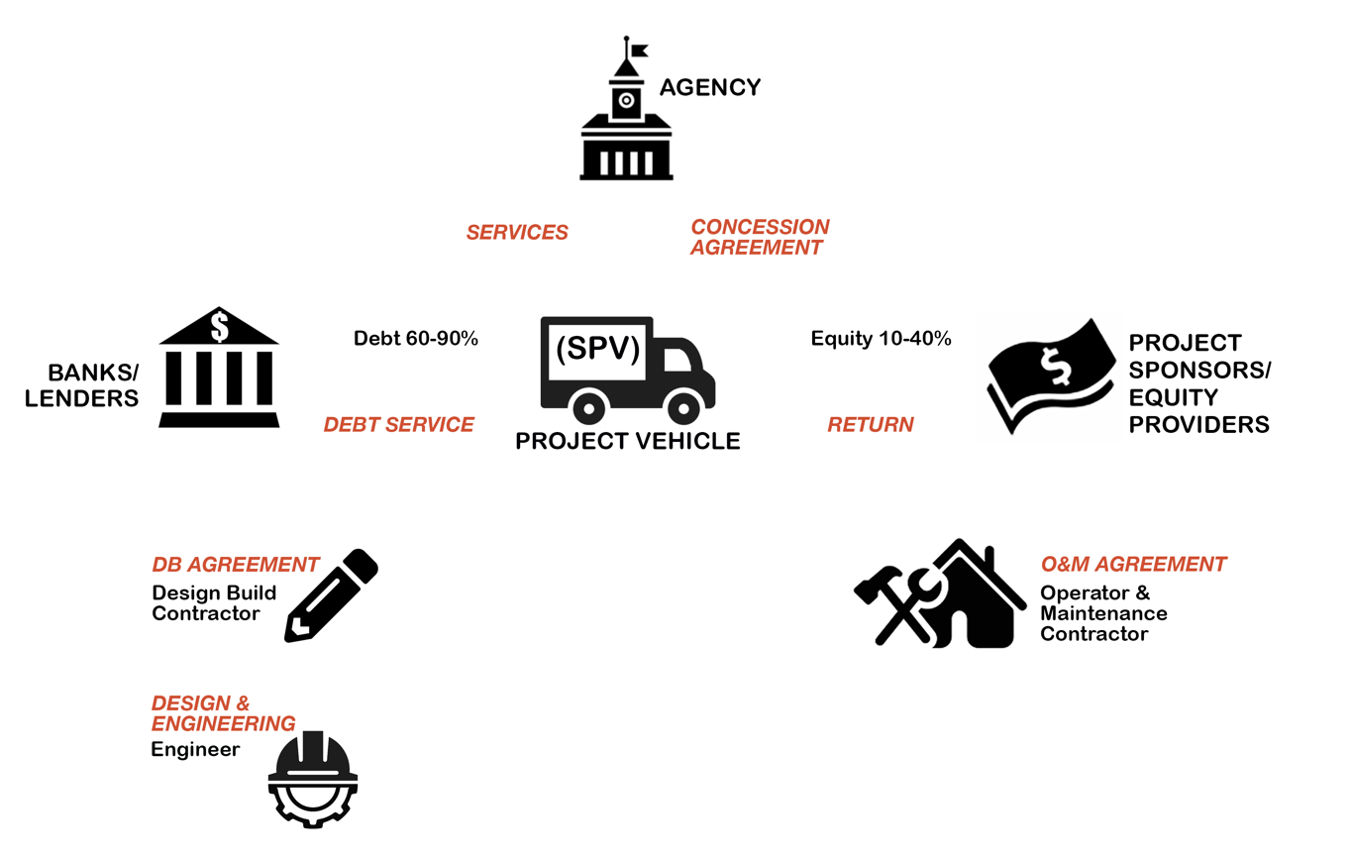
Typical P3 Structure

Slide 20

Transparency for Taxpayers: Buckets of Risk
DEVELOPMENT
RISK
COMPLETION
RISK
LIFECYCLE
RISK
DEMAND
RISK
COUNTERPARTY
RISK
Design
Cost
Schedule
Site Conditions
Land Acquisition
Entitlement
Permitting/Environmental
Maintenance/Repair
Energy Sources
Revenue
(Sources)
Creditworthiness
Appropriations
THREE THINGS YOU CAN DO WITH RISK – Retain, Transfer, Mitigate

Slide 21
Funding vs. Financing
FUNDING
FINANCING
Public money made available to the project. This contributed capital is not intended to be repaid or carry a cost (i.e., interest or return on investment).
Money provided by private investors to pay for construction costs, concession payments and other large project costs. This capital is intended to be repaid and does carry a cost (i.e., interest and return on investment).
Typical sources include:
TAXES
General fund
Project or specific use allocation
Pay as you go
GRANTS or FUNDING PROGRAMS
PROJECT REVENUES
Tolls
Value capture
PROPERTY DEVELOPMENT REVENUES
Typical sources include:
DEBT
Municipal Private Activity Bonds (tax exempt or taxable)
Private placement
Bank loans
EQUITY
Shares
Deeply subordinated debt
FEDERAL CREDIT PROGRAMS
Shares
Deeply subordinated debt
Notes:
Kyle will speak on funding (salary) vs. Financing (real estate agent and bank)
LTFP
Voter referendums for new capital taxation vs. Operating costs

Slide 22
Getting started
Managing Consultants
Remain in control of the process. Take into consideration the advisors’ advice but retain the role of decision-maker and providing the voice for the agency.
Owners should be comfortable with seeking additional input if their advisors make recommendations that are new or foreign to the usual processes.
Aligning Public and Private Incentives
Goals and incentives for all parties must be aligned for a successful project. This can be achieved through honest negotiations and communication between all parties.
The private partner should be motivated to deliver and manage a quality project.
Early Private Sector Engagement
Market sounding should begin before ideas are fully set, but after some initial planning.
Early discussion on risk can test if assumptions match-up with the industry perceptions.
Political Support
A political champion is required to help guide the project through key points.
The owner should ensure that a key governmental advocate(s) is deeply engaged in the project and can help guide these sensitive issues to assist with ensuring buy-in from local business leaders.

Slide 23
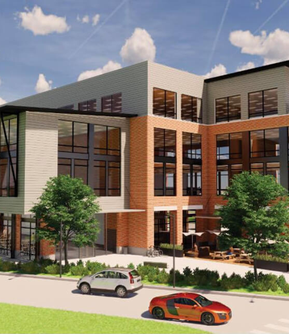


City of Pflugerville Downtown East
Pflugerville, TX
Project Description:
The City of Pflugerville is using a public-private partnership (P3) delivery model to develop the 29-acre Pfluger Tract as an extension of its historic downtown. The project is anchored by a new City Hall, which broke ground in December 2024 and topped out a few days ago, a multi-generational recreation center, a new civic plaza, and the extension of Main Street. In addition, the city will host a mixed-use development of up to 700,000 square feet of community-serving commercial development, including multifamily residential, office, retail, and hospitality. The project will be constructed by a Master Developer.
  Project Highlights:
  Progressive P3 delivery of civic center and commercial development
  City Hall
  Multigenerational recreation facility
  Units of residential apartments
  Retail
  Open space and outdoor entertainment
  Community Goals:
  “By utilizing a public-private partnership (P3), the City of Pflugerville shifts the risk of delivering the project to a Master Developer and reduces the overall cost to construct the needed city facilities by accelerating the development timeline and sharing the cost of infrastructure within the site including roads, sewer, water and other utilities.”
  The goal is to create a vibrant, equitable, and sustainable neighborhood in Pflugerville’s historic downtown that brings together housing, jobs, retail, dining, recreation, and civic spaces in a walkable, family-friendly environment. Through strategic public-private partnerships, thoughtful design, and infrastructure efficiencies, the project will deliver a new city hall, a multi-generational recreation center, and other high-quality amenities that optimize taxpayer investment, generate long-term revenue, and minimize risk. Rooted in community engagement and guided by the Downtown Action Plan, the development will celebrate Pflugerville’s culture and heritage, enhance connections to trails and open spaces, and catalyze downtown revitalization while ensuring long-term resilience and growth.
23

Slide 24
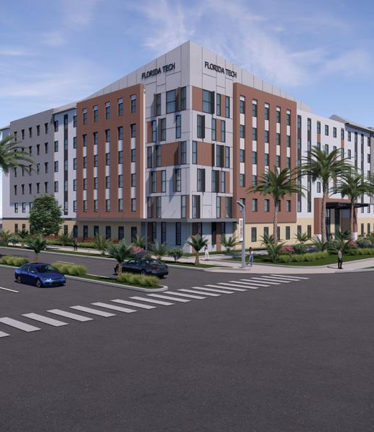
Florida Institute of Technology Housing
Melbourne, FL
Owner | Florida Institute of Technology
Value | $100 Million
Financial Close | Spring 2025
Delivery Structure | Progressive Development: Design-Build-Finance-Operate-Maintain – Ground Lease
Project Team | Developer/Property Management: Servitas Design: Zyscovich/BRPH General Contractor: CBG Building Company
Background:
Florida Tech is experiencing an enrollment increase and needs additional on-campus housing to meet its needs. Florida Tech also realized the benefits that a public-private partnership (P3) would bring to the University via competitive bids, competing designs and approaches, private sector financing, risk transfer and more. After a multi-month competitive process, Florida Tech, with guidance from its P3 Advisor, Brailsford & Dunlavey, selected the private sector team that provided the most value to the University.
  Project Scope: The project will deliver to Florida Tech a new six-story, 149-unit, 556-bed, 212,000 SF residence hall and associated amenities. All units are apartment-style. The majority of the units will be four-bedroom, two-bathroom suites equipped with full kitchens, providing modern and comfortable living spaces for students. Amenities will include a classroom area, study and lounge spaces, a multipurpose room, fitness center, game room, e-bike parking, and two outdoor courtyards designed for dining and recreation - with BBQ grills, a shaded patio, and a multi-use field, and on site parking.
  The project is built on a greenfield on-campus site owned by the University. The site is ground-leased to the Developer who will Design, Build, Finance, Operate, and Maintain the new residence hall. Via a collaborative Progressive P3 Approach, once the Team was selected based on its qualifications, vision, design, and initial budget, the Team and Florida Tech embarked on a multi-month collaborative effort to refine the Team's initial vision and plan, address local and state requirements, refine budgets, structure the project agreement and close the financing package.
24

Slide 25

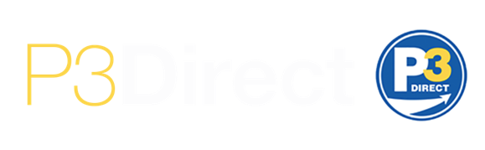

Run by public sector P3 experts, P3Direct is a program implemented by AIAI for the public sector as a means to create a connection between experienced P3 professionals and those looking to gain more information on the P3 procurement model across agencies at every level.
P3Direct provides an opportunity for public officials to both engage with P3 experts and share their experiences.
The program encourages an understanding of the model, and collaboration of agencies to promote best practices and share lessons learned and success stories around P3s.
516.277.2950 | theP3team@AIAI-Infra.org | www.aiai-infra.org

